Slide 1
6.4 Simplification of Incompletely Specified Functions
Example
Don’t care terms are treated like required minterms

Slide 2
6.4 Simplification of Incompletely Specified Functions
Don’t care columns are omitted when forming the PI chart
If we replace each term in the final expression for F
The don’t care terms in the original truth table for F

Slide 3
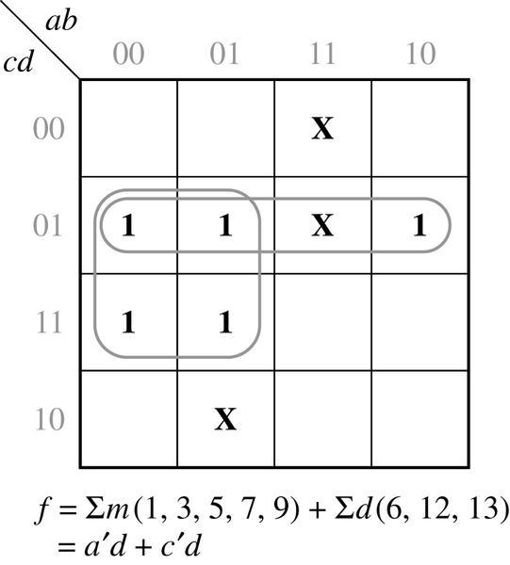
6.4 Simplification of Incompletely Specified Functions
Exercise fig 5-13 in Ch. 5
Don’t care term

Slide 4
6.4 Simplification of Incompletely Specified Functions
Determination of Prime Implicants (fig 5-13)

Slide 5
6.4 Simplification of Incompletely Specified Functions
Prime Implicant Chart (fig 5-13)
⊗
Essential Prime Implicant :
⊗

Slide 6
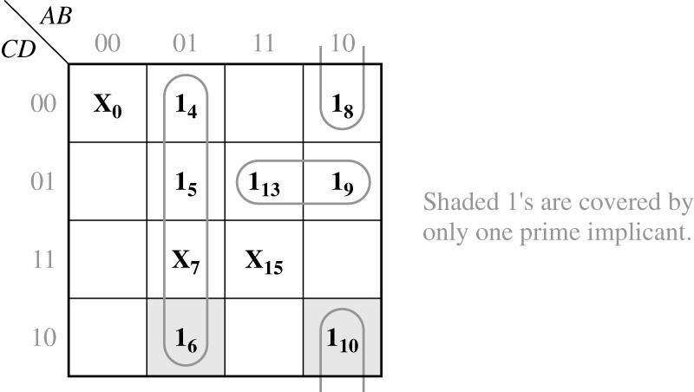
6.4 Simplification of Incompletely Specified Functions
Exercise fig 5-20 in Ch. 5

Slide 7
6.4 Simplification of Incompletely Specified Functions
Determination of Prime Implicants (fig 5-20)

Slide 8
6.4 Simplification of Incompletely Specified Functions
Prime Implicant Chart (fig 5-20)
⊗
Essential Prime Implicant :
⊗

Slide 9
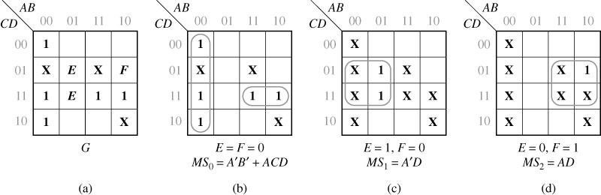
6.5 Simplification Using Map-Entered Variables
Using Map-Entered Variables (Figure 6-1)
E = F = 1 ?
The map represents the 6-variable function
Notes:
Why not E=F=1?
This case is already covered when (E=1, F=0) and (E=0, F=1)

Slide 10
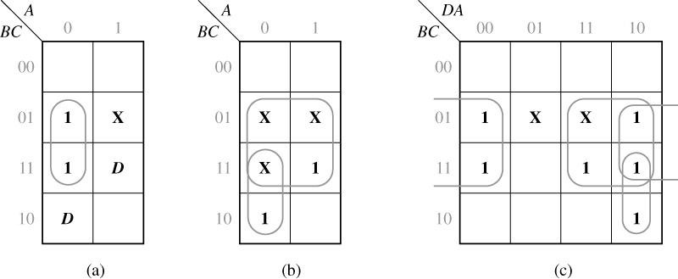
6.5 Simplification Using Map-Entered Variables
Example: a 3-variable map to simplify the function
Don’t care
Simplification Using a Map-Entered Variable (Figure 6-2)
From Figure 6-2(a) and (b)
Prove with figure c
D = 0
D = 1

Slide 11
6.5 Simplification Using Map-Entered Variables
Find a sum-of-products expression for F of the form
MS₀ : minimum sum obtained by P₁=P₂=…=0
MS₁ : minimum sum obtained by P₁=1, P_{j}=0 (j=/ 1) and replacing
all ‘1’’s on the map with ‘don’t cares(X)’
MS₂ :….
The resulting expression is a minimum sum of products for G (Fig. 6-1)

